Slide 1
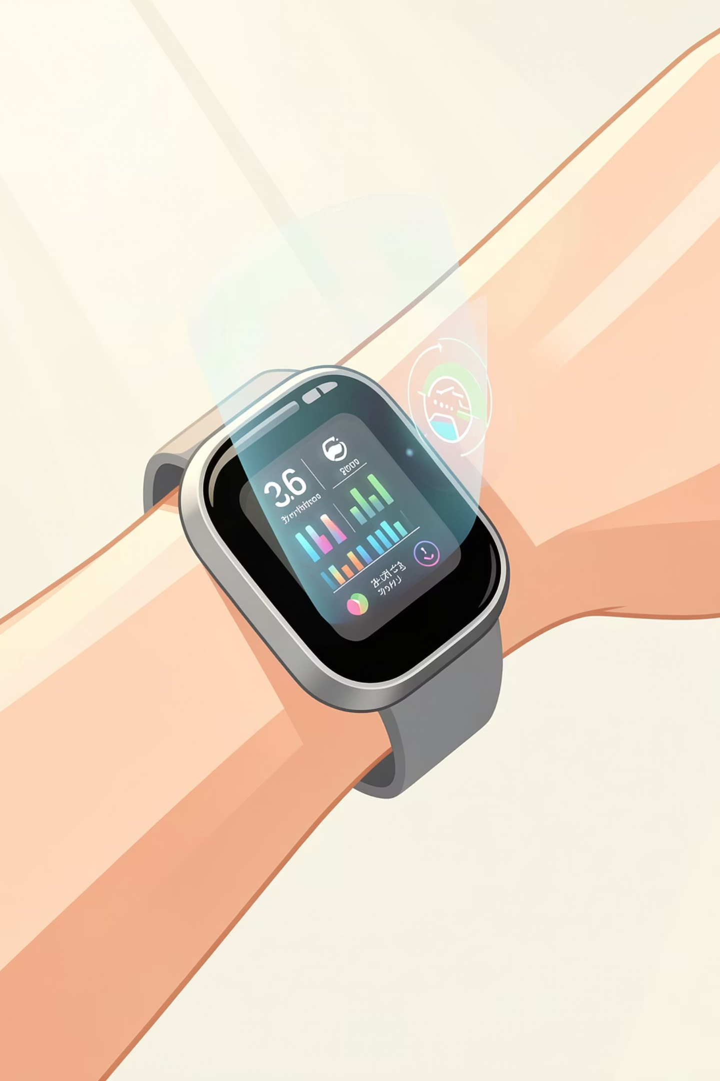
Fitbit Data Exploration
Uncovering patterns in user activity, engagement, and fitness behavior through comprehensive analysis of wearable tracker data

Slide 2

PROJECT OVERVIEW
Understanding Fitness Through Data
This exploratory data analysis examines Fitbit fitness tracker data to reveal how users engage with their devices and maintain their fitness routines. By merging multiple datasets, we analyzed key metrics including steps, distance, calories burned, and activity intensity across both individual users and time periods.
The analysis combines quantitative metrics with user behavior patterns to paint a comprehensive picture of fitness tracker usage and effectiveness.

Slide 3
Data Integration & Preparation
01
02
Data Collection
Dataset Merging
Gathered multiple Fitbit datasets including activity logs, daily summaries, and intensity measurements from diverse user groups
Integrated data sources at user and date levels to create comprehensive analysis views
03
04
Data Cleaning
Aggregation
Standardized formats, handled missing values, and validated data quality across all metrics
Calculated summary statistics and created analytical frameworks for deeper insights

Slide 4

Key Metrics Analyzed
Total Steps
Distance Traveled
Daily step counts tracked to measure overall physical activity levels and identify movement patterns across different user segments
Miles covered per day used as a primary indicator for fitness category classification and engagement analysis
Calories Burned
Activity Intensity
Energy expenditure measurements correlating activity intensity with metabolic output throughout the day
Minutes spent in light, moderate, and vigorous activity zones to understand workout quality and effort distribution

Slide 5
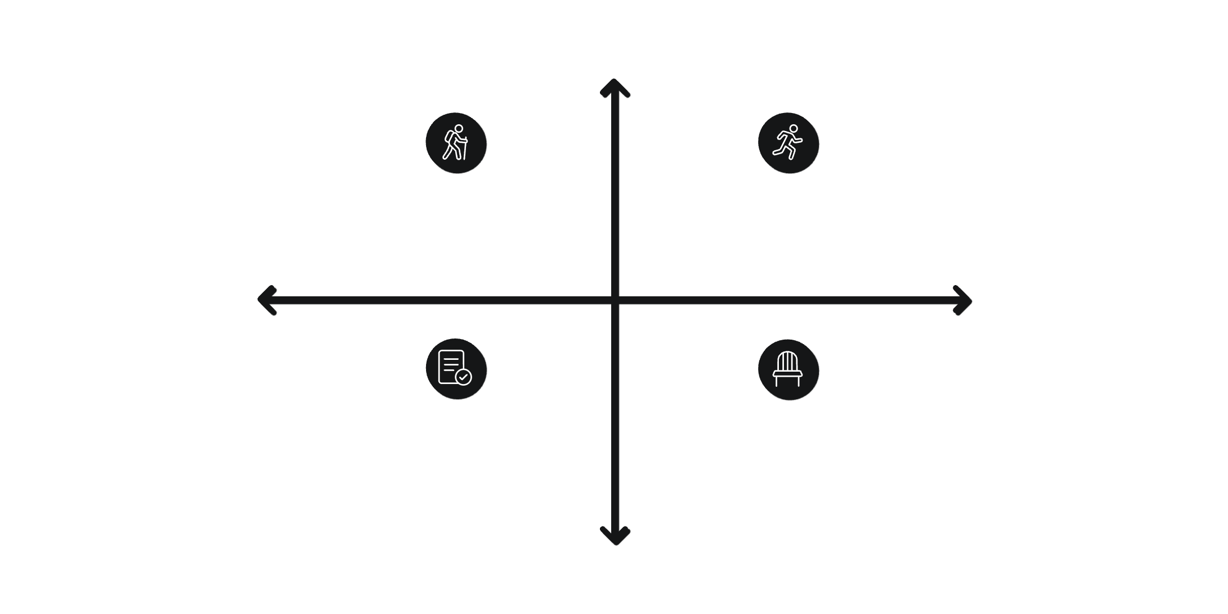
User Segmentation Strategy
Segmentation Criteria
High Average Distance
Tracker Usage Dimension: Frequency of device synchronization and data logging to measure engagement commitment
Active Engagers - High activity, low syncs
Highly Engaged Actives - High activity, frequent syncs
Low Tracker Usage
High Tracker Usage
Fitness Level Dimension: Average daily distance traveled categorizes users from sedentary to highly active
Passive Actives - Low activity, frequent syncs
Sedentary Low-Engagers - Low activity, low syncs
This two-factor approach reveals nuanced patterns that single-metric segmentation would miss, identifying power users, casual trackers, and at-risk churners.
Low Average Distance
Our dual-axis segmentation model enables precise targeting of user groups for personalized interventions and product improvements.

Slide 6
KEY FINDINGS
Activity Variation Patterns
Step Count Variance
Calorie Burn Correlation
Active Minutes Distribution
Significant fluctuations in daily steps across user groups, with highly active users averaging 3x more steps than sedentary users. Weekend activity typically drops 22% compared to weekdays.
Strong positive correlation (r=0.87) between distance traveled and calories burned, though individual metabolic rates create notable outliers in the 15-20% range.
Only 34% of users meet CDC guidelines for weekly active minutes. High performers accumulate 85% of their activity during 5-7pm window, suggesting post-work exercise routines.

Slide 7
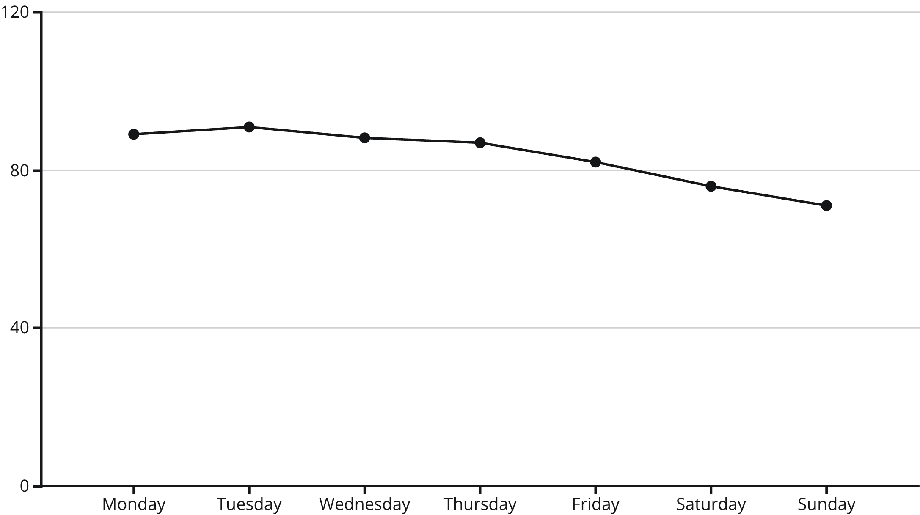
Daily Participation Trends
Weekly Engagement Cycle
User participation follows a predictable weekly pattern, peaking early in the week and declining toward the weekend. This 18-point drop from Monday to Sunday suggests reduced accountability on non-work days.
Implication: Weekend-focused engagement campaigns could help maintain consistent tracker usage and prevent habit disruption.

Slide 8

User Engagement Insights
High Engagement Users
Moderate Engagement Users
Low Engagement Users
17% of users sync daily and average 12,000+ steps. These power users demonstrate consistent patterns and rarely miss logging days, making them ideal candidates for premium features and community leadership roles.
54% of the user base shows sporadic tracking with 3-5 sync days per week. This group has the highest growth potential through targeted nudges and simplified goal-setting interfaces.
29% sync less than twice weekly with declining activity trends. Early intervention strategies are critical to prevent churn in this at-risk segment within the first 30 days.

Slide 9
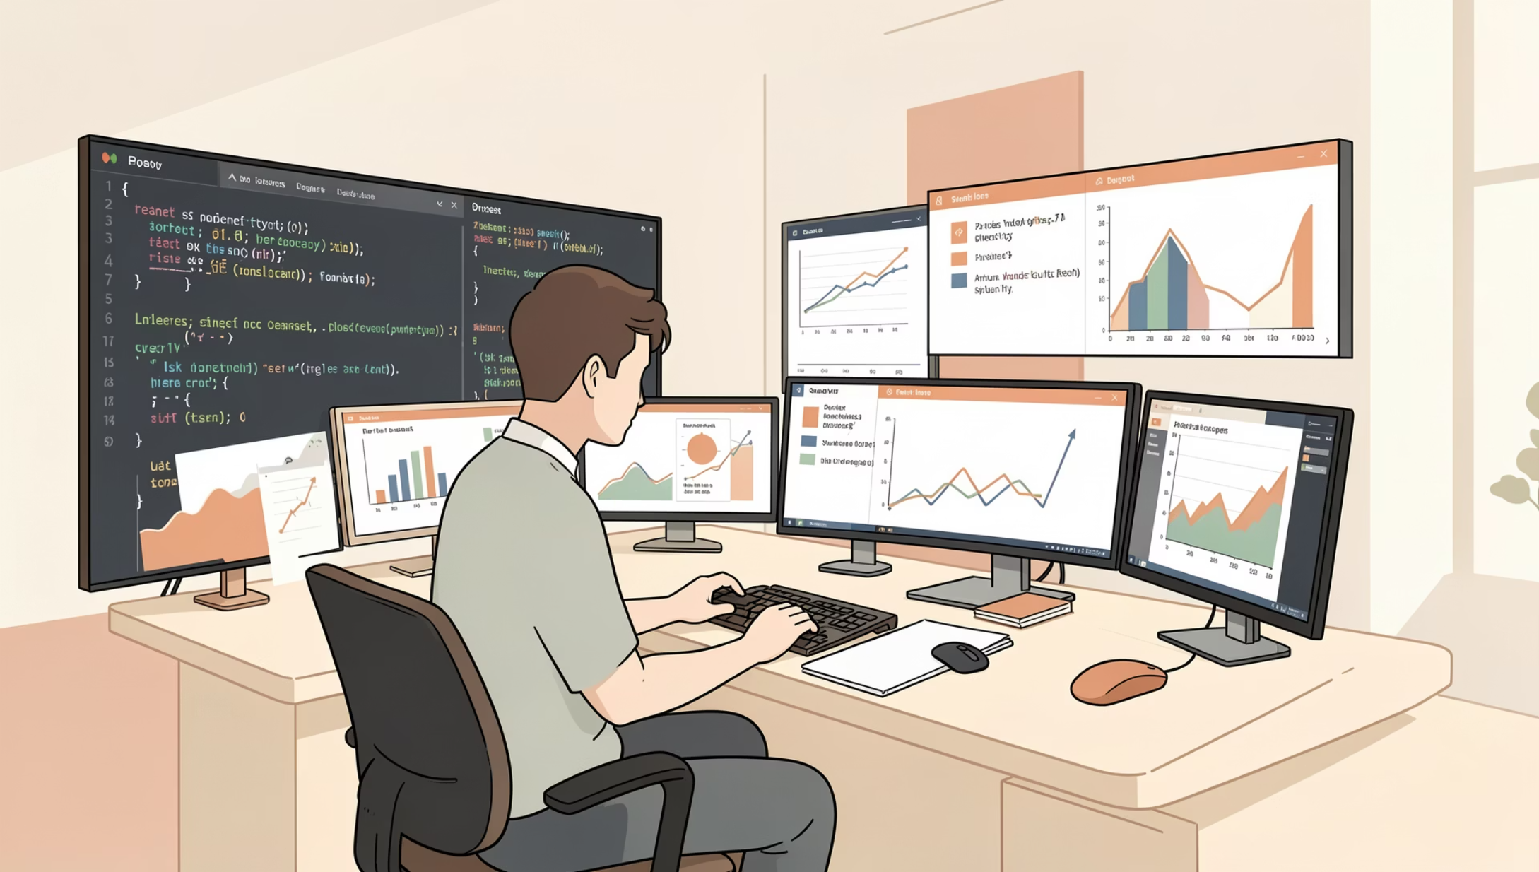
TECHNICAL SKILLS
Analytical Capabilities Demonstrated
Core Competencies
Data Cleaning: Handled inconsistent formats, null values, and outlier detection across multiple datasets
Data Merging: Integrated disparate sources using user IDs and timestamps as keys
Aggregation: Created summary statistics at user and temporal levels
Segmentation: Applied multi-dimensional clustering to identify user archetypes
Visualization: Developed clear, actionable charts to communicate findings

Slide 10



Project Impact & Takeaways
Actionable Insights
Pattern Recognition
Data-Driven Foundation
Identified specific user segments requiring tailored engagement strategies to improve retention
Revealed daily and weekly fluctuations that inform optimal timing for user notifications
Established analytical framework for ongoing fitness tracker data exploration and product optimization
This EDA demonstrates proficiency in transforming raw wearable data into meaningful insights that drive product strategy and user experience improvements in the health technology space.

